Slide 1




ECG Arrhythmia Classification Using
STFT-Based Spectrogram and Convolutional Neural Network
Published in IEEE Access
Authors:
Jingshan Huang, Binqiang Chen, Bin Yao, Wangpeng He.
Presented by:
210169L- W.W.R..N.S. Fernando
210730B- W.M. Wimalasiri
1

Slide 2



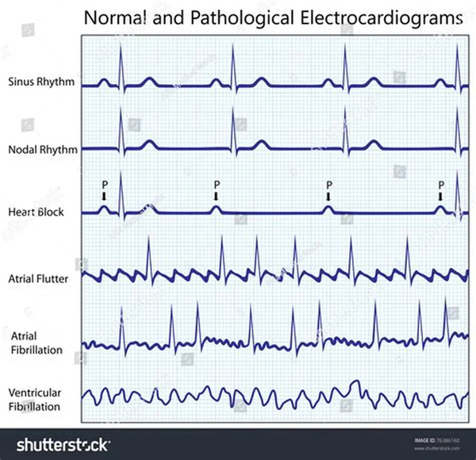
Cardiovascular Health & Need for ECG Analysis
Role of ECG (Electrocardiogram)
Why This Matters?
Arrhythmia
Leading global cause of death
~17.7 million deaths per year (~31% of total deaths).
75% occur in developing countries.
Key diagnostic tool for monitoring heart rhythm.
Records excitability, transmission, recovery of heart.
Group of abnormal heart rhythms; can occur alone or with other CVDs.
Critical to detect for prevention & treatment
2

Slide 3

Introduction & Background
Traditional ECG Classification
Why Look for Something Better
Need a method that captures both time and frequency variations.
Need a representation that is deep-learning friendly (automatic feature learning).
Want to avoid hand-crafted features completely.
Insight That Led to the Solution
CNNs learn patterns best from images.
So, if we convert ECG signals → visual patterns, CNNs can detect rhythm differences automatically.
Direction Chose
Use Short-Time Fourier Transform (STFT) to convert each 10-s ECG window into a time–frequency spectrogram.
Feed these spectrogram images into a 2D CNN → automatic feature learning.
Step 1
Step 2
Feature Extraction
Pattern Classification
Threshold-based methods.
Digital filters.
Wavelet Transform (WPD, WT, PCA).
Entropy measures, AR models, nonlinear features.
Classifiers:
SVM
Neural Networks
Random Forest
K-NN
OPF
Limitation
Require heavy manual feature engineering
Perform poorly across different patients/devices
ECG signals are non-stationary, fixed features cannot describe these changes well.
3

Slide 4
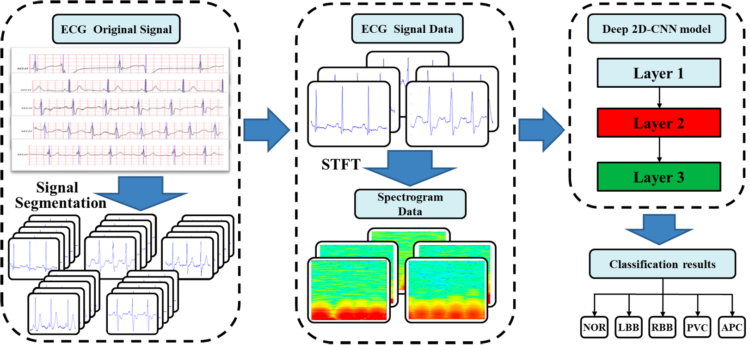
Method Overview
Classification of Arrhythmias using 2D CNN Classifier
Transformation into time-frequency spectogram
5 heartbeat types:
Normal (NOR)
Left bundle branch block (LBB)
Right bundle branch block (RBB)
Premature ventricular contraction (PVC)
Atrial premature contraction (APC)
Apply Short Term Fourier Transform to ECG time series 1D data
Proposed ECG arrhythmia classification pipeline
J. Huang, B. Chen, B. Yao and W. He, "ECG Arrhythmia Classification Using STFT-Based Spectrogram and Convolutional Neural Network," in IEEE Access, vol. 7, pp. 92871-92880, 2019, doi: 10.1109/ACCESS.2019.2928017.
4

Slide 5
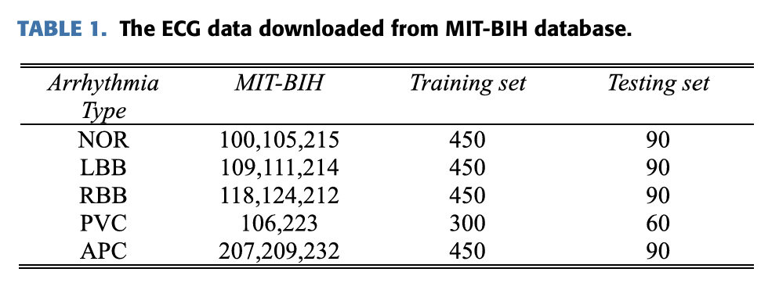
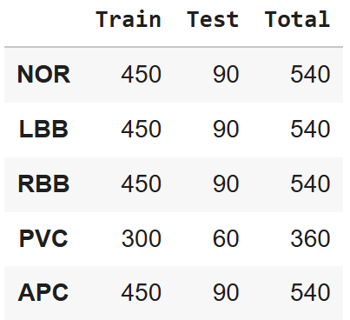
Implementation Details
Dataset & Preprocessing
Dataset: MIT-BIH Arrhythmia Database
Choose V5 lead
make sure the sampling rate is 360Hz
segment the signals into 10s.
Do the training and testing set splits from each category
Extracted recordings:
Total = 2520 samples
Training set: 2,100 samples
Testing set: 420 samples
Balanced across the 5 arrhythmia classes
5
Notes:
V5 lead (or MLII if V5 isn’t available)

Slide 6
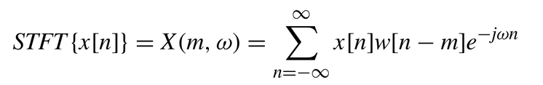
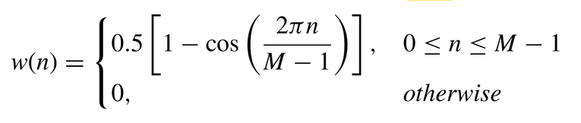
Implementation Details
Dataset & Preprocessing
apply STFT
Hanning window 50% overlap.
window size is 512
Time-frequency spectrogram
256 × 256 × 1
time domain ECG 10s segments
Convert class labels into one-hot vectors
Stack all spectrogram tensors into model-ready arrays
train_X_2d and test_X_2d
6

Slide 7
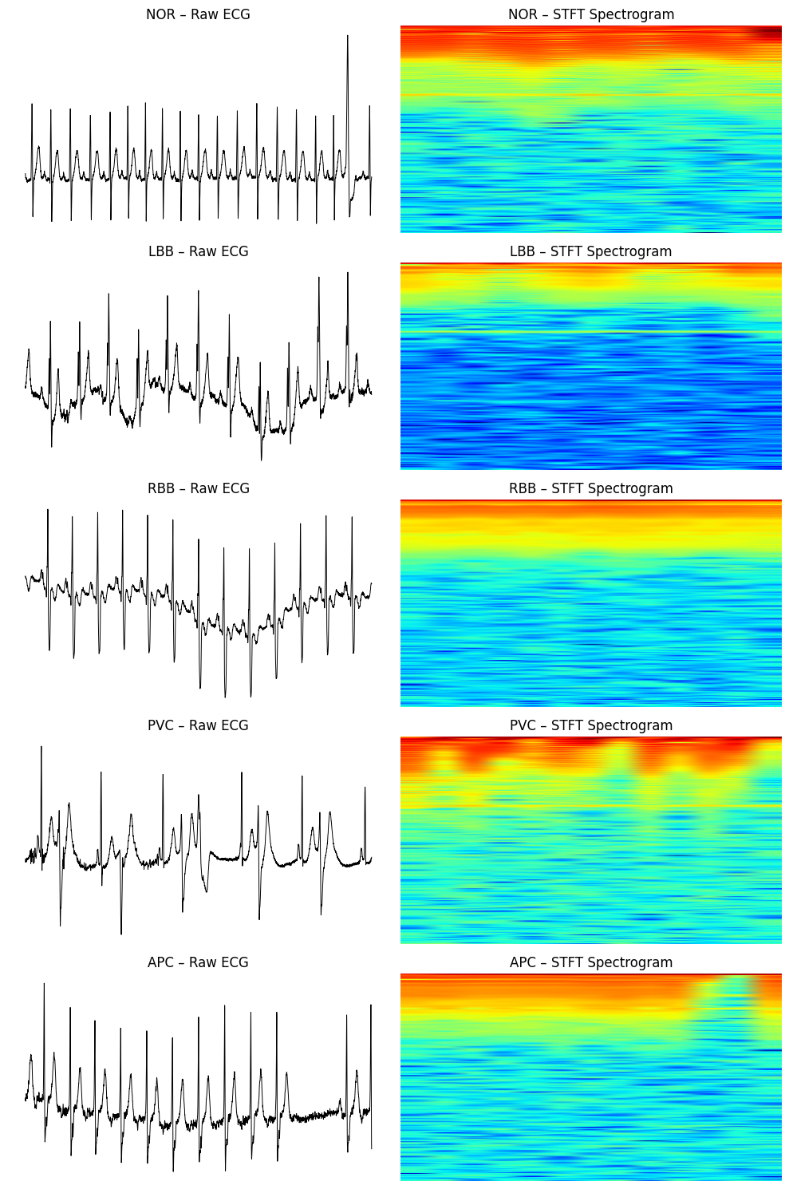
Implementation Details
Dataset & Preprocessing
7

Slide 8
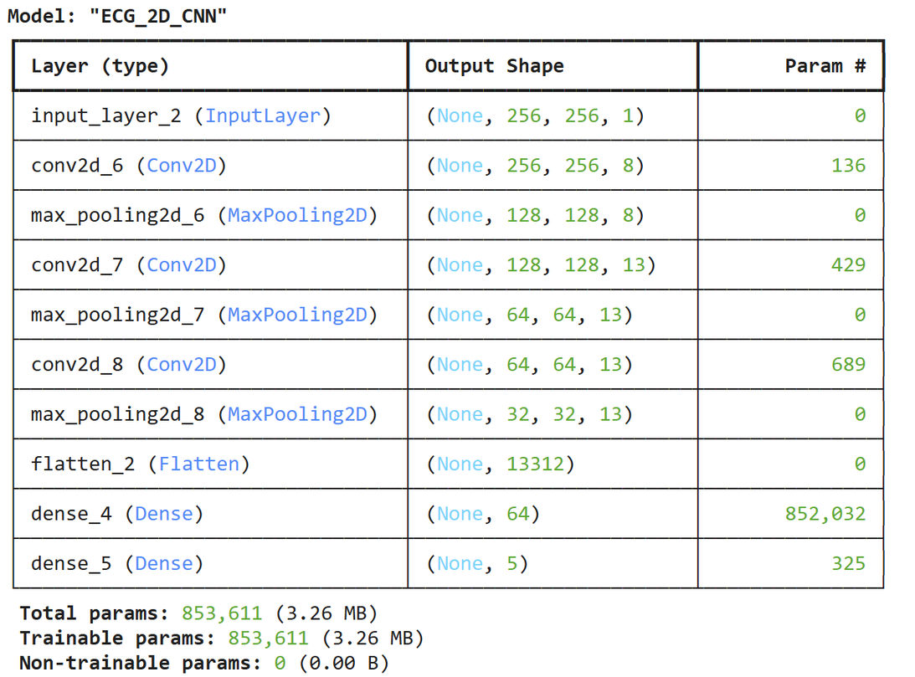
Implementation Details
Model Architecture
Input:
256×256 STFT spectrogram (grayscale)
CNN Feature Extractor:
Conv(8, 4×4) → MaxPool
Conv(13, 2×2) → MaxPool
Conv(13, 2×2) → MaxPool
Classifier:
Flatten → Dense(64) → Dense(5, softmax)
Total params:
~853k (lightweight & fast)
8

Slide 9
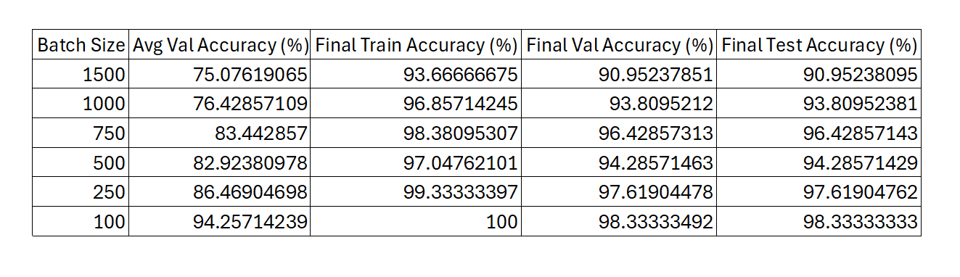
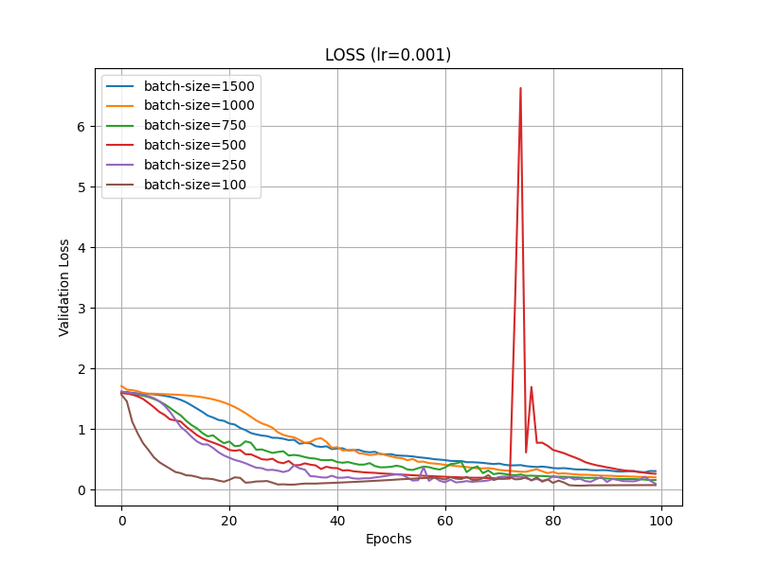
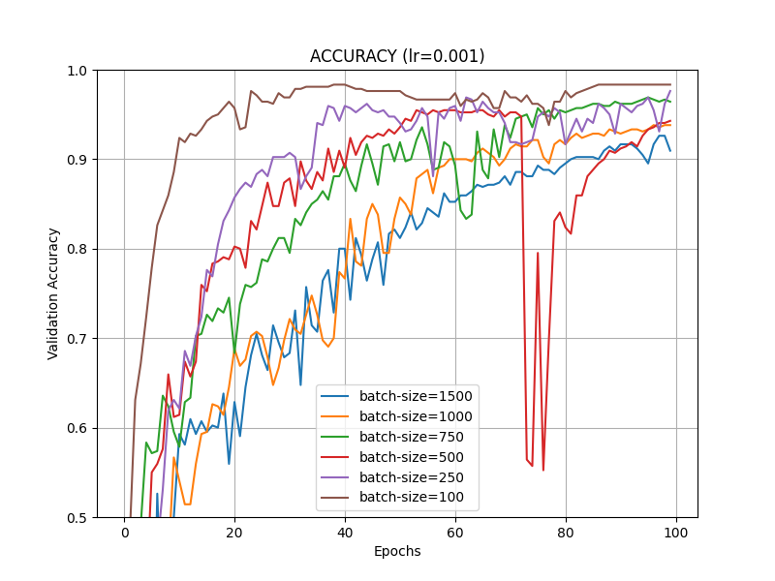
Results
Fixed learning rate of 0.001
epochs=100
9
Notes:
To find the best classification performance, we tested the model using several different parameter settings and compared the results.
smaller batch sizes lead to higher validation and test accuracy. In our experiments, batch size 100 achieved the best performance, reaching about 98% validation and test accuracy, which is very close to the paper’s reported accuracy. As the batch size increases, the model’s ability to generalize gradually decreases—batch sizes like 1000 and 1500 fall to the 90–93% range.
The loss and accuracy curves also reflect this behavior: smaller batch sizes converge faster, remain stable, and consistently achieve higher accuracy, while larger batches learn more slowly and reach lower overall performance. Overall, our results successfully reproduce the paper’s results at smaller batch sizes but results have droped in higher batch sizes.

Slide 10
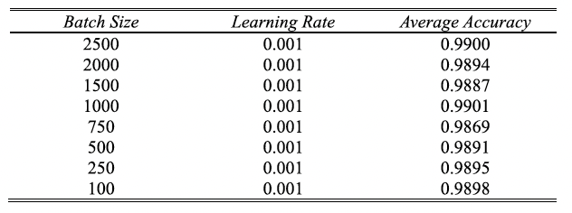
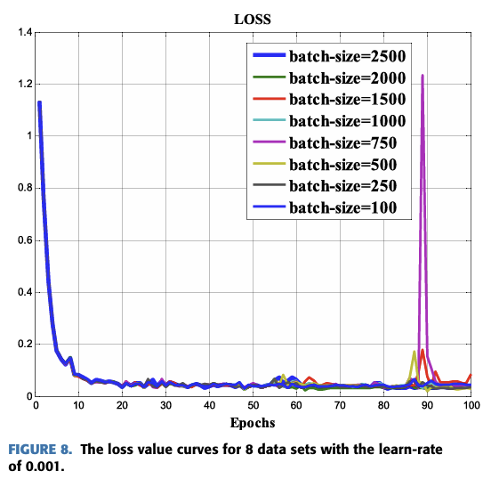
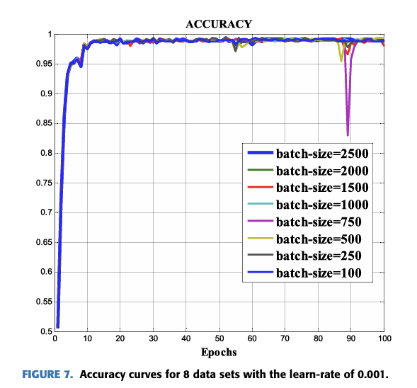
Results
Fixed learning rate of 0.001
epochs=100
Our results
Results from paper
10
Notes:
To find the best classification performance, we tested the model using several different parameter settings and compared the results.
smaller batch sizes lead to higher validation and test accuracy. In our experiments, batch size 100 achieved the best performance, reaching about 98% validation and test accuracy, which is very close to the paper’s reported accuracy. As the batch size increases, the model’s ability to generalize gradually decreases—batch sizes like 1000 and 1500 fall to the 90–93% range.
The loss and accuracy curves also reflect this behavior: smaller batch sizes converge faster, remain stable, and consistently achieve higher accuracy, while larger batches learn more slowly and reach lower overall performance. Overall, our results successfully reproduce the paper’s results at smaller batch sizes but results have droped in higher batch sizes.

Slide 11
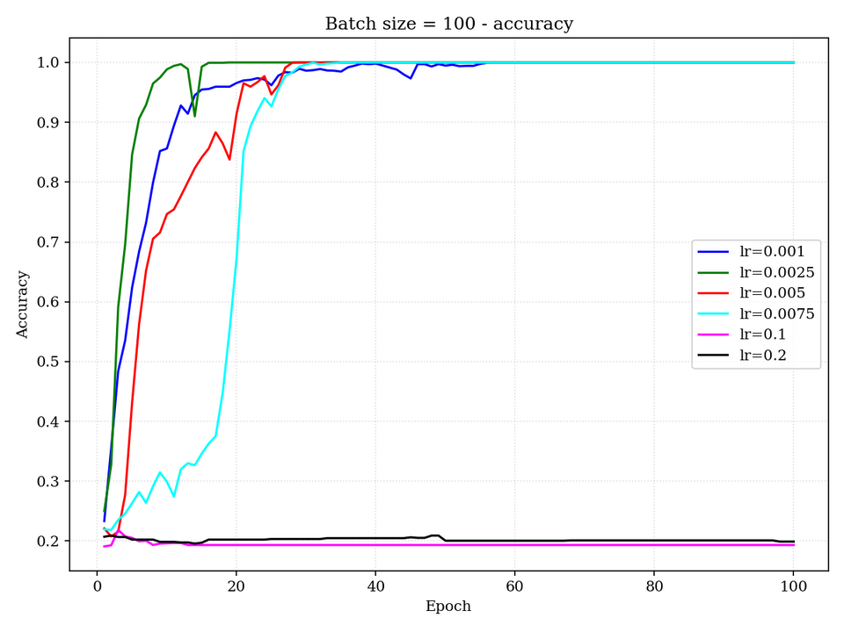
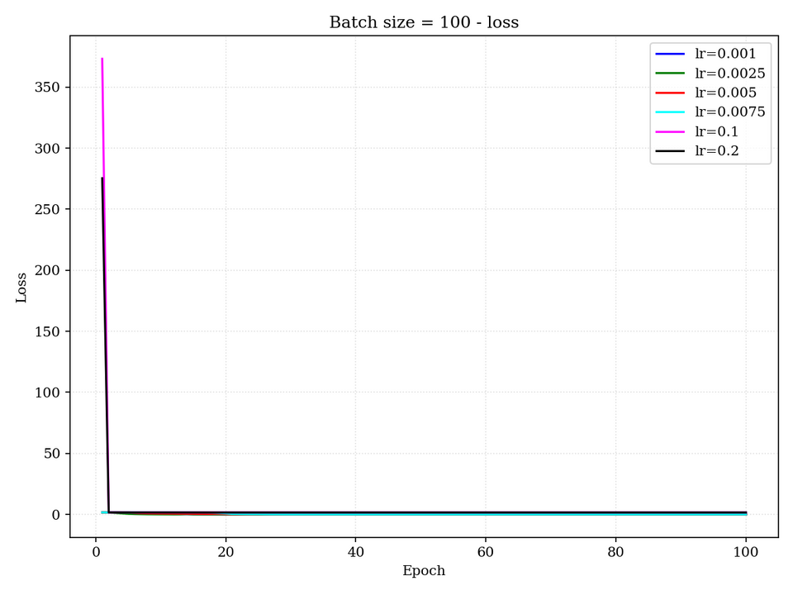
Results
Fixed batch size of 100
epochs=100
11

Slide 12
Results
Fixed batch size of 100
epochs=100
12

Slide 13
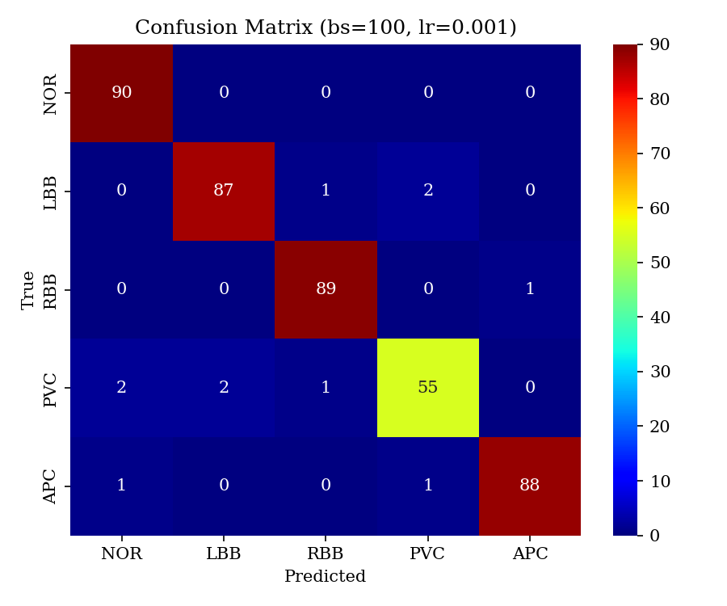
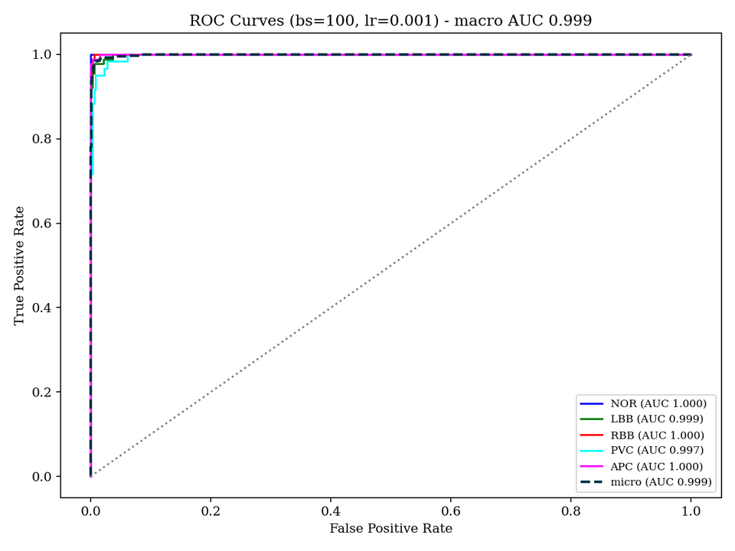
Results
Fixed batch size of 100
epochs=100
13

Slide 14
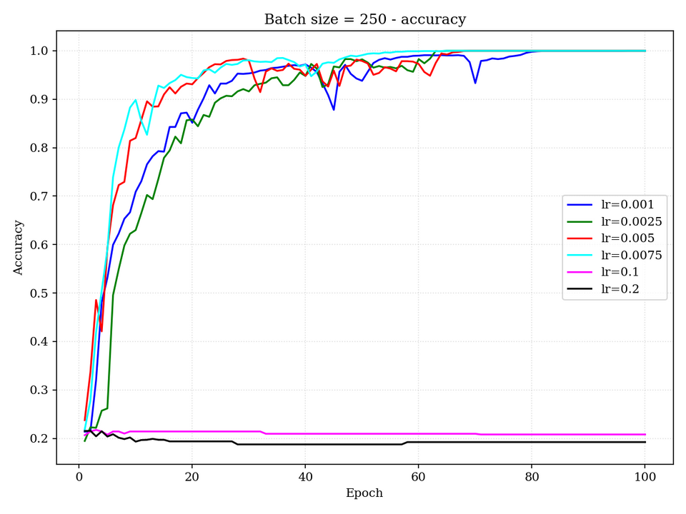
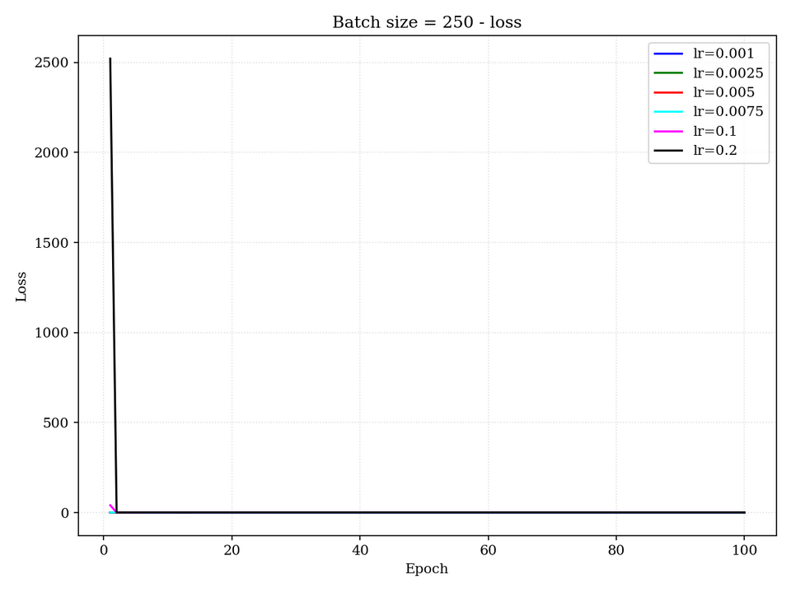
Results
Fixed batch size of 250
epochs=100
14

Slide 15
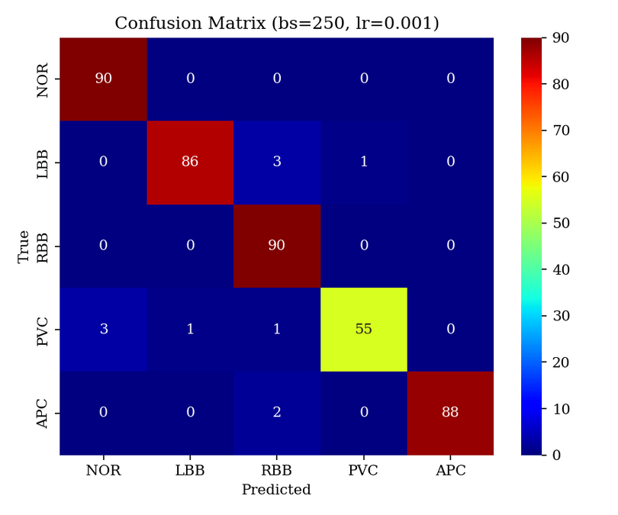
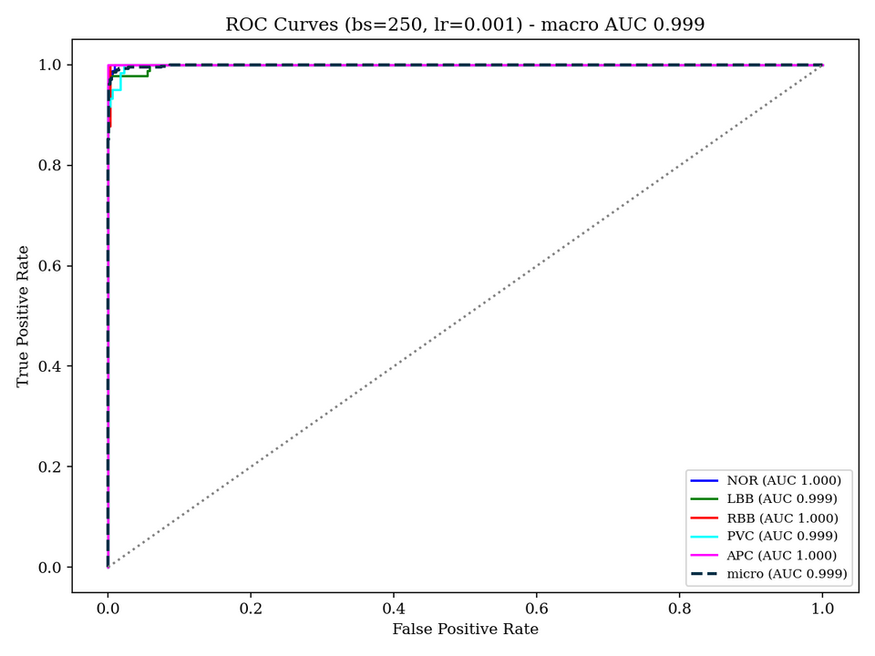
Results
Fixed batch size of 250
epochs=100
15

Slide 16
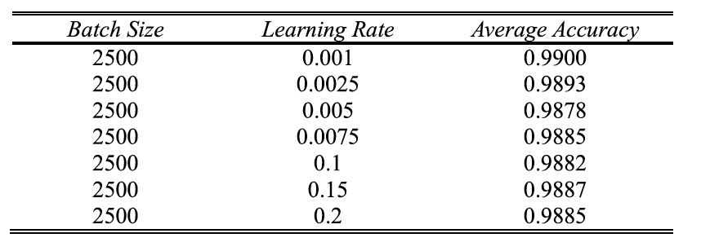
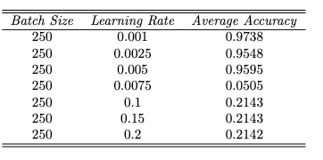
Analysis
Fixed batch size of 250
epochs=100
Paper Implementation
Paper Replication
16

Slide 17
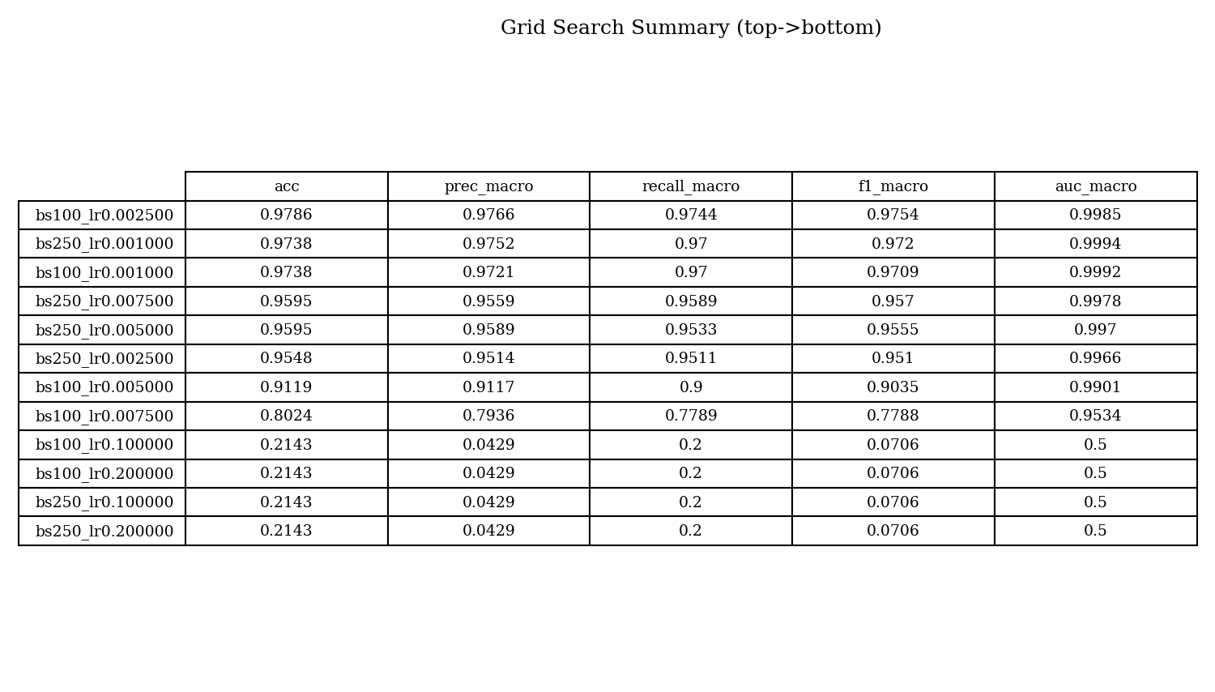
Results
17

Slide 18
Discussion
The best performance was achieved with a batch size of 250 and a learning rate of 0.001, resulting in a learning accuracy of 99.3% and an overall accuracy of 97.3%, with a precision of 97.5%, recall of 97% and F1-Score of 97.2%.
18

Slide 19
Proposed Improvement & Implementation
Original paper uses only one STFT window (512 samples).
A single window cannot capture all ECG events:
Fast, high-frequency QRS → need small window.
Slow, low-frequency P/T waves → need large window.
Result:
Loss of information → some wave features become blurred.
Our Proposed Enhancement
Adaptive Multi-Window STFT Front-End
We compute three spectrograms using window sizes 128, 256, 512.
These are stacked as a 3-channel (RGB-like) input to the CNN.
Why Multi-Window STFT?
Each reveals different ECG characteristics.
Stacking them gives a richer time–frequency representation.
19

Slide 20
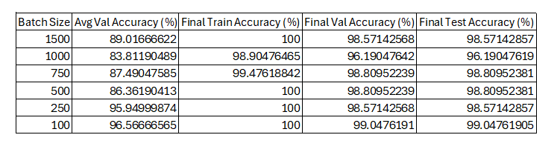
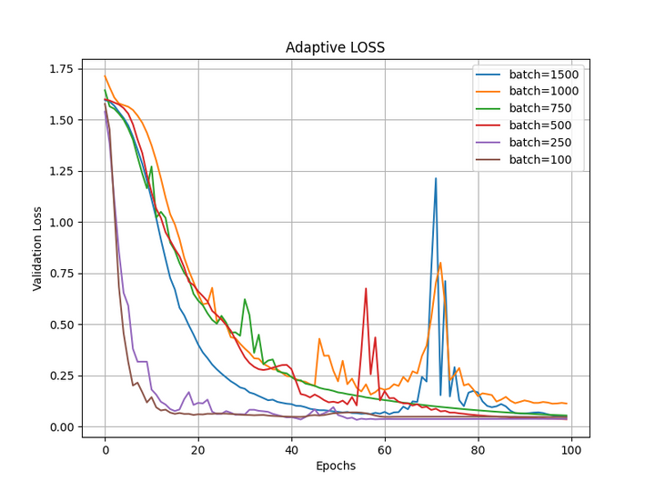
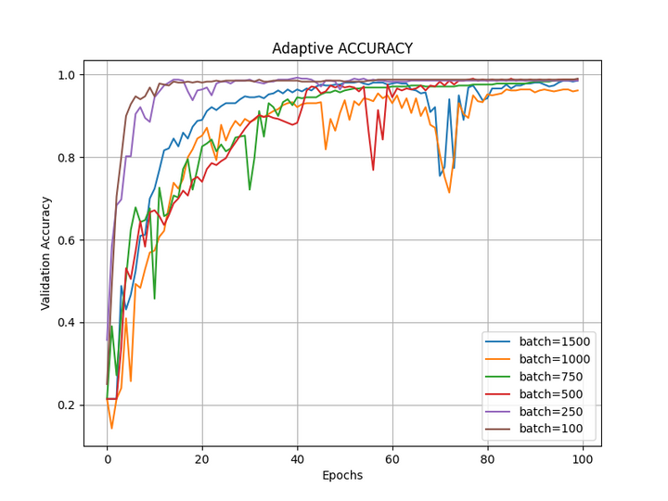
Results after applying the improvement
20

Slide 21
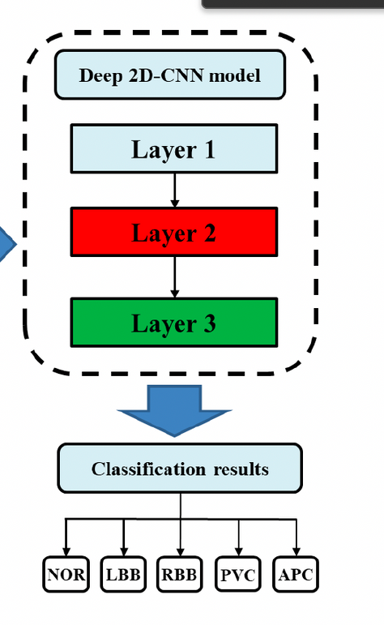
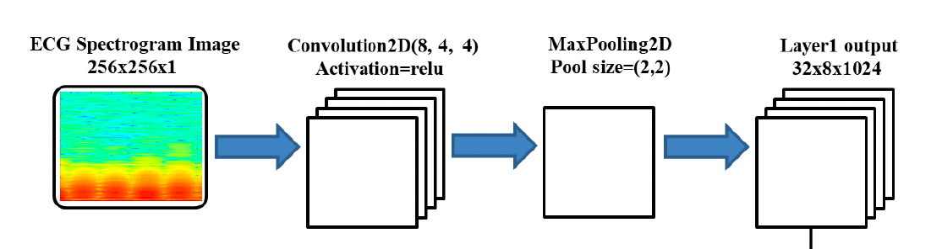
Challenges
Insufficient information on the neural network
Claims the output shapes but cannot obtain those shapes with the given one kernel and maxpooling layer
21

Slide 22
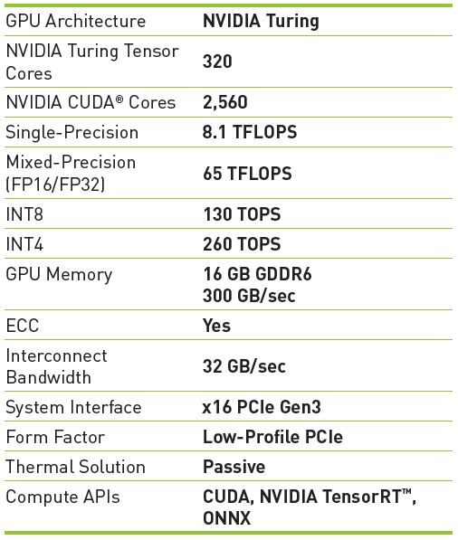
Challenges
Inadequate computer resources
Batch size of 2500 was used in the paper.
Tried with two T4 GPUs.
22

Slide 23
Possible Improvement
Hilbert Huang Transform
Emperical Mode Decomposition- Decomposes a signal into Intrinsic Modes defined by Intrinsic Mode
ECG signals are non-linear and non-stationary
Need to extract characteristic components of underlying biological processes
EMD is fully adaptive, unsupervised and data-driven
Consider oscillations locally and separate data into locally non-overlapping time-scale components
Hilbert Transform- to construct a unique analytic signal from a given real signal so
that instantaneous amplitude and frequency can be analyzed
Fourier has a constant amplitude and frequency for each sinusoid.
HHT has a time-varying amplitude and frequency
One possible Enhancement
Hilbert Transform applied on EMD IMFs
23

Slide 24
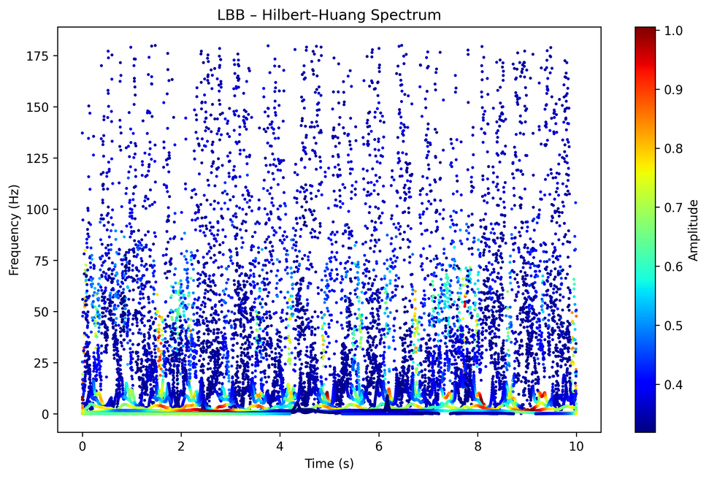
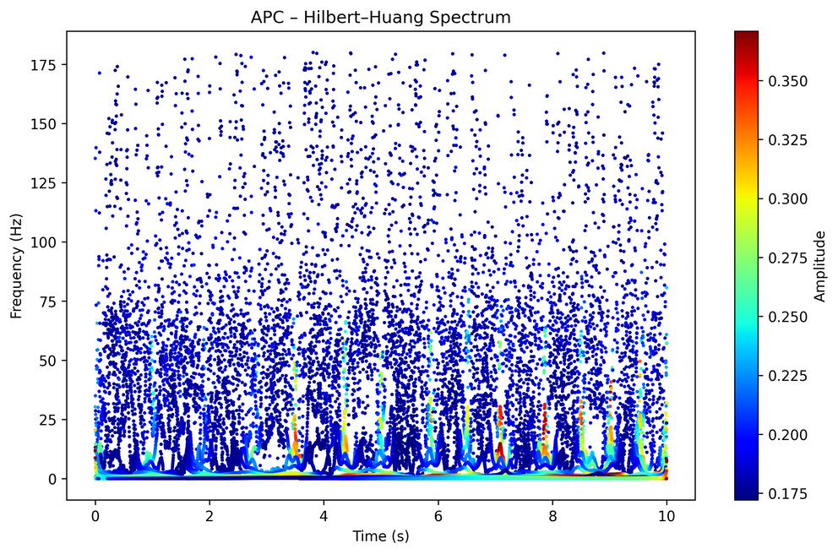
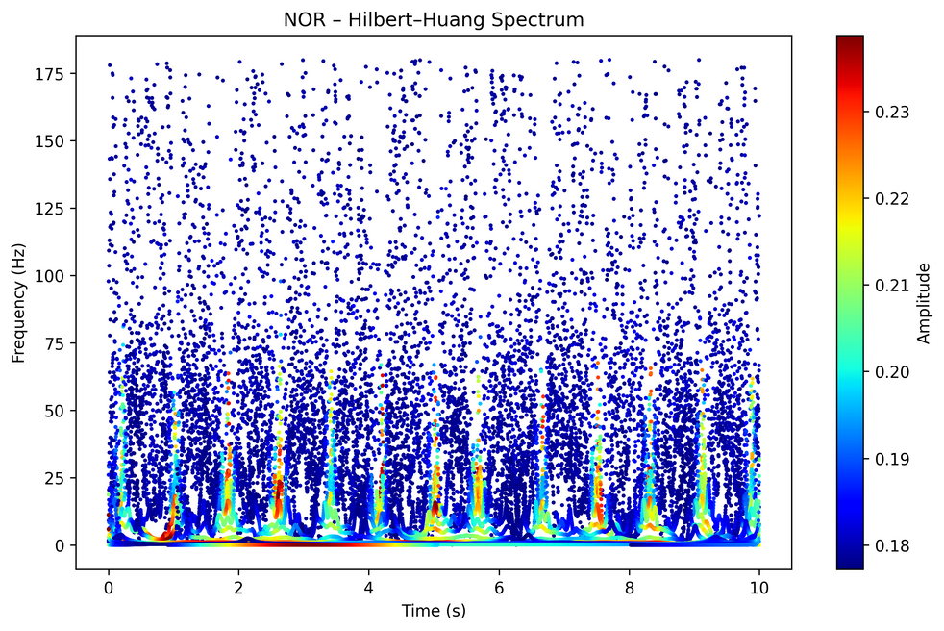
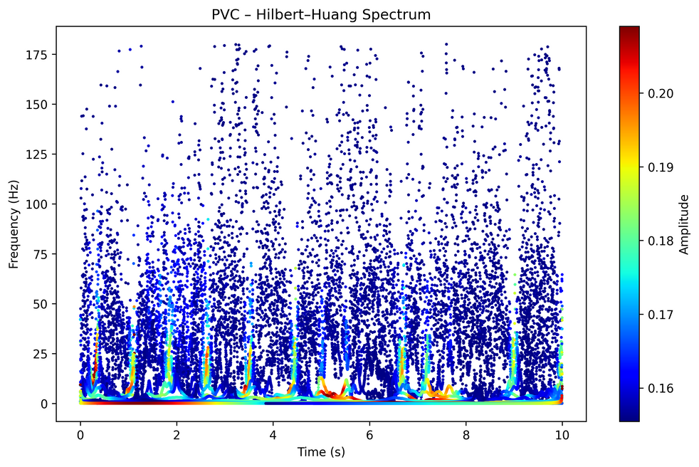
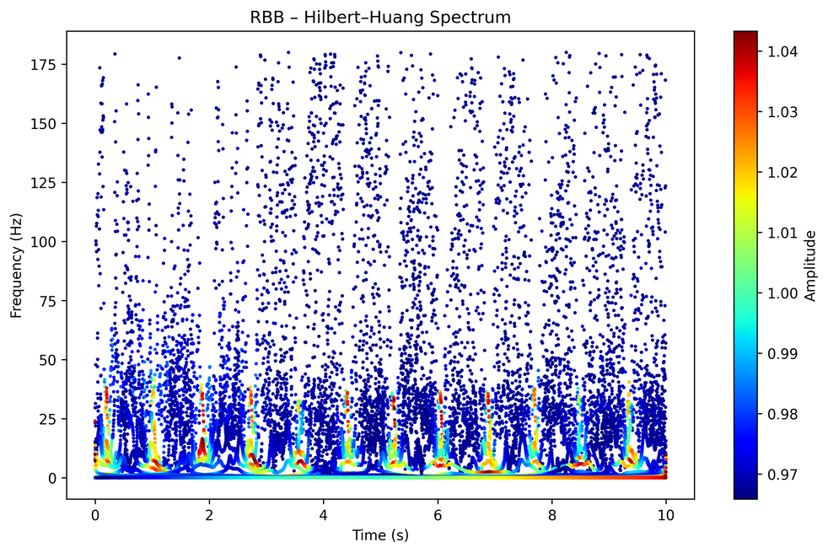
Possible Improvement
24

Slide 25
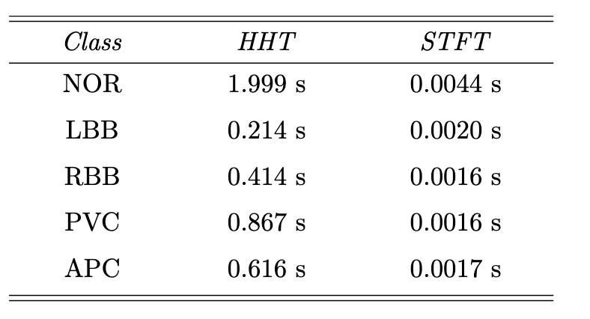
Possible Improvement
But, estimating envelopes: over-sampling and cubic splines are costly.
Therefore, while it may provide accurate predictions, the model would require significant training and inference time.
25

Slide 26
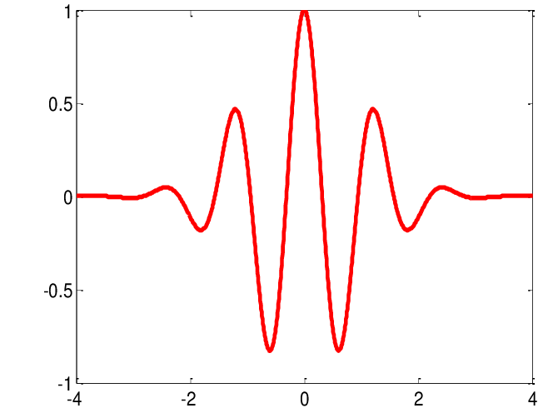
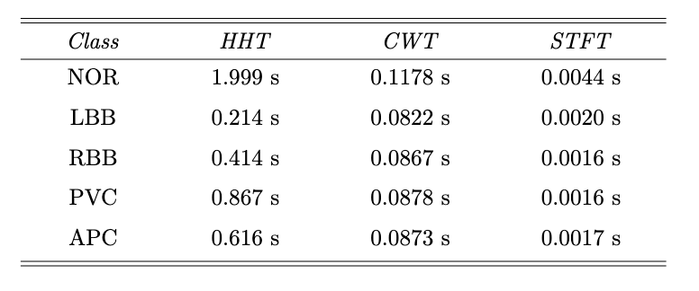
Possible Improvement
Furthermore, we explored the use of the Continuous Wavelet Transform (CWT) with the Morlet wavelet, as it provides a sinusoidal kernel rather than a time-limited one, potentially offering more informative time-frequency analysis.
Morlet wavelet
26

Slide 27
Learnings
ECG Arrhythmia Classification performed on five rhythm types:
Normal beat (NOR)
Left bundle branch block (LBB)
Right bundle branch block (RBB)
Premature ventricular contraction (PVC)
Atrial premature contraction (APC)
Model: Deep 2D Convolutional Neural Network (2D-CNN)
Input Representation:
Spectrogram images generated using Short-Time Fourier Transform (STFT)
Best Hyperparameters:
Batch size: 250
Learning rate: 0.001
Future Enhancement:
Replace standard STFT with an Adaptive Multi-Window STFT
27

Slide 28

Thank
You
28

